Slide 1
Email Attachment from IW Email 9/2
Dear Dr Lyden,
We performed TTC staining on 1 mm brain sections from all the 9 surviving mice.
Unfortunately, the infarct area is barely visible and hence we are not able to quantify it manually.
Kindly advise.
I have attached a file for your reference.
Thanks
Nirav
Note: IW Day 28 was completed 9/5

Slide 2
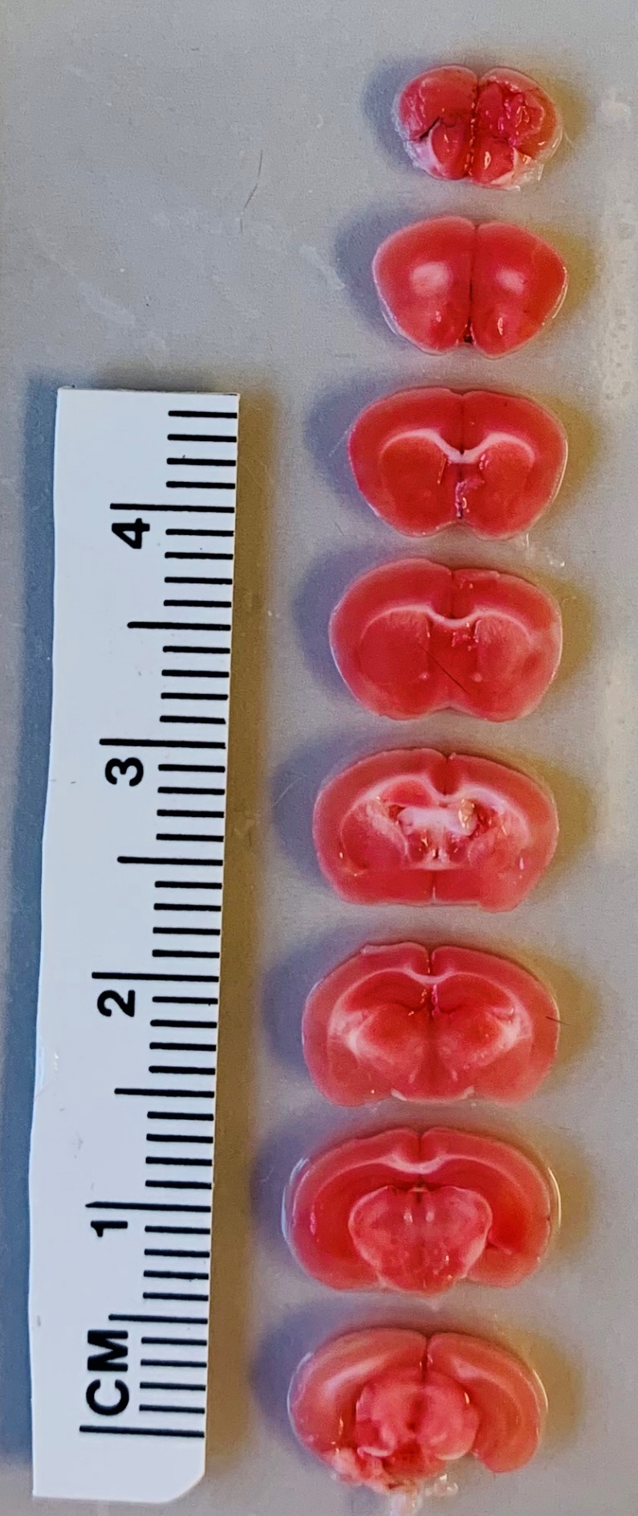
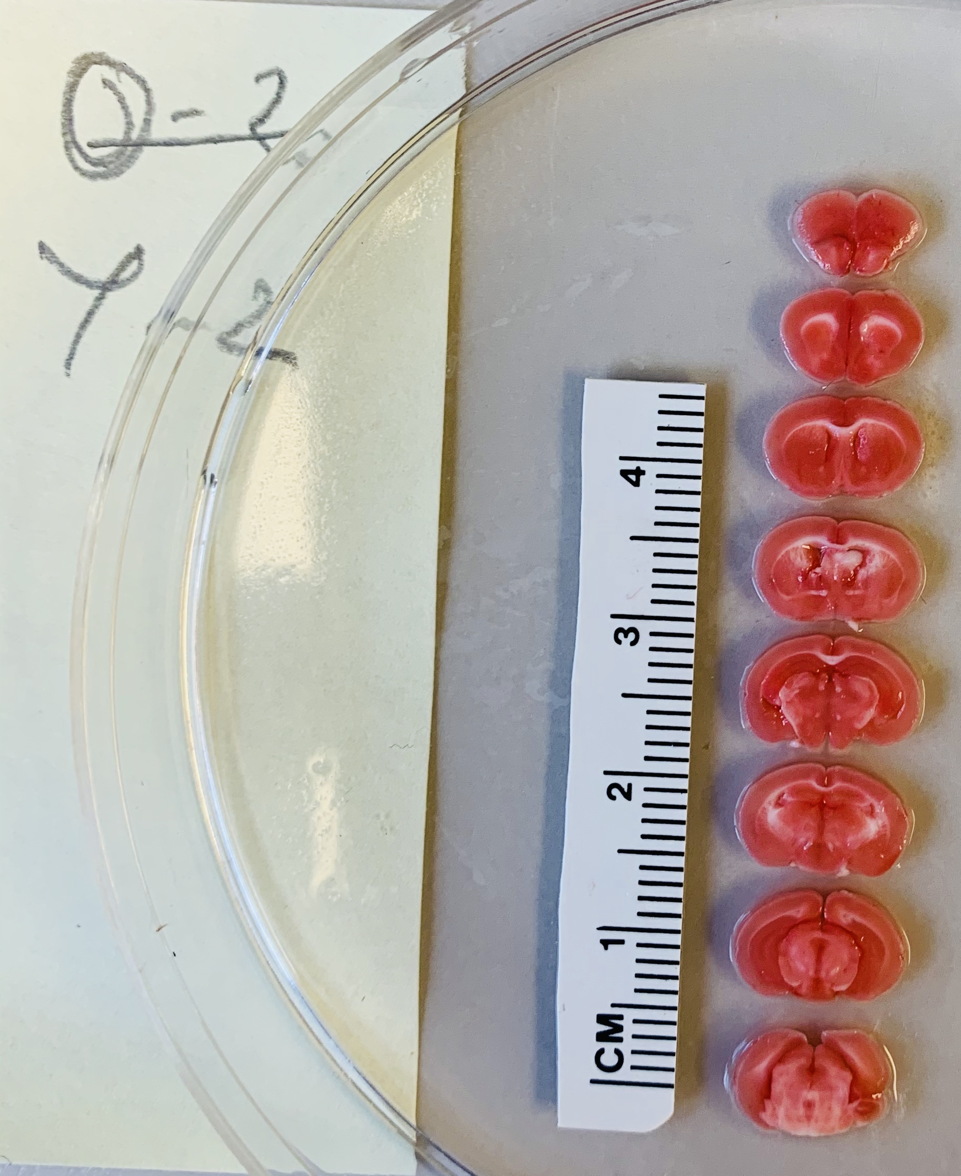
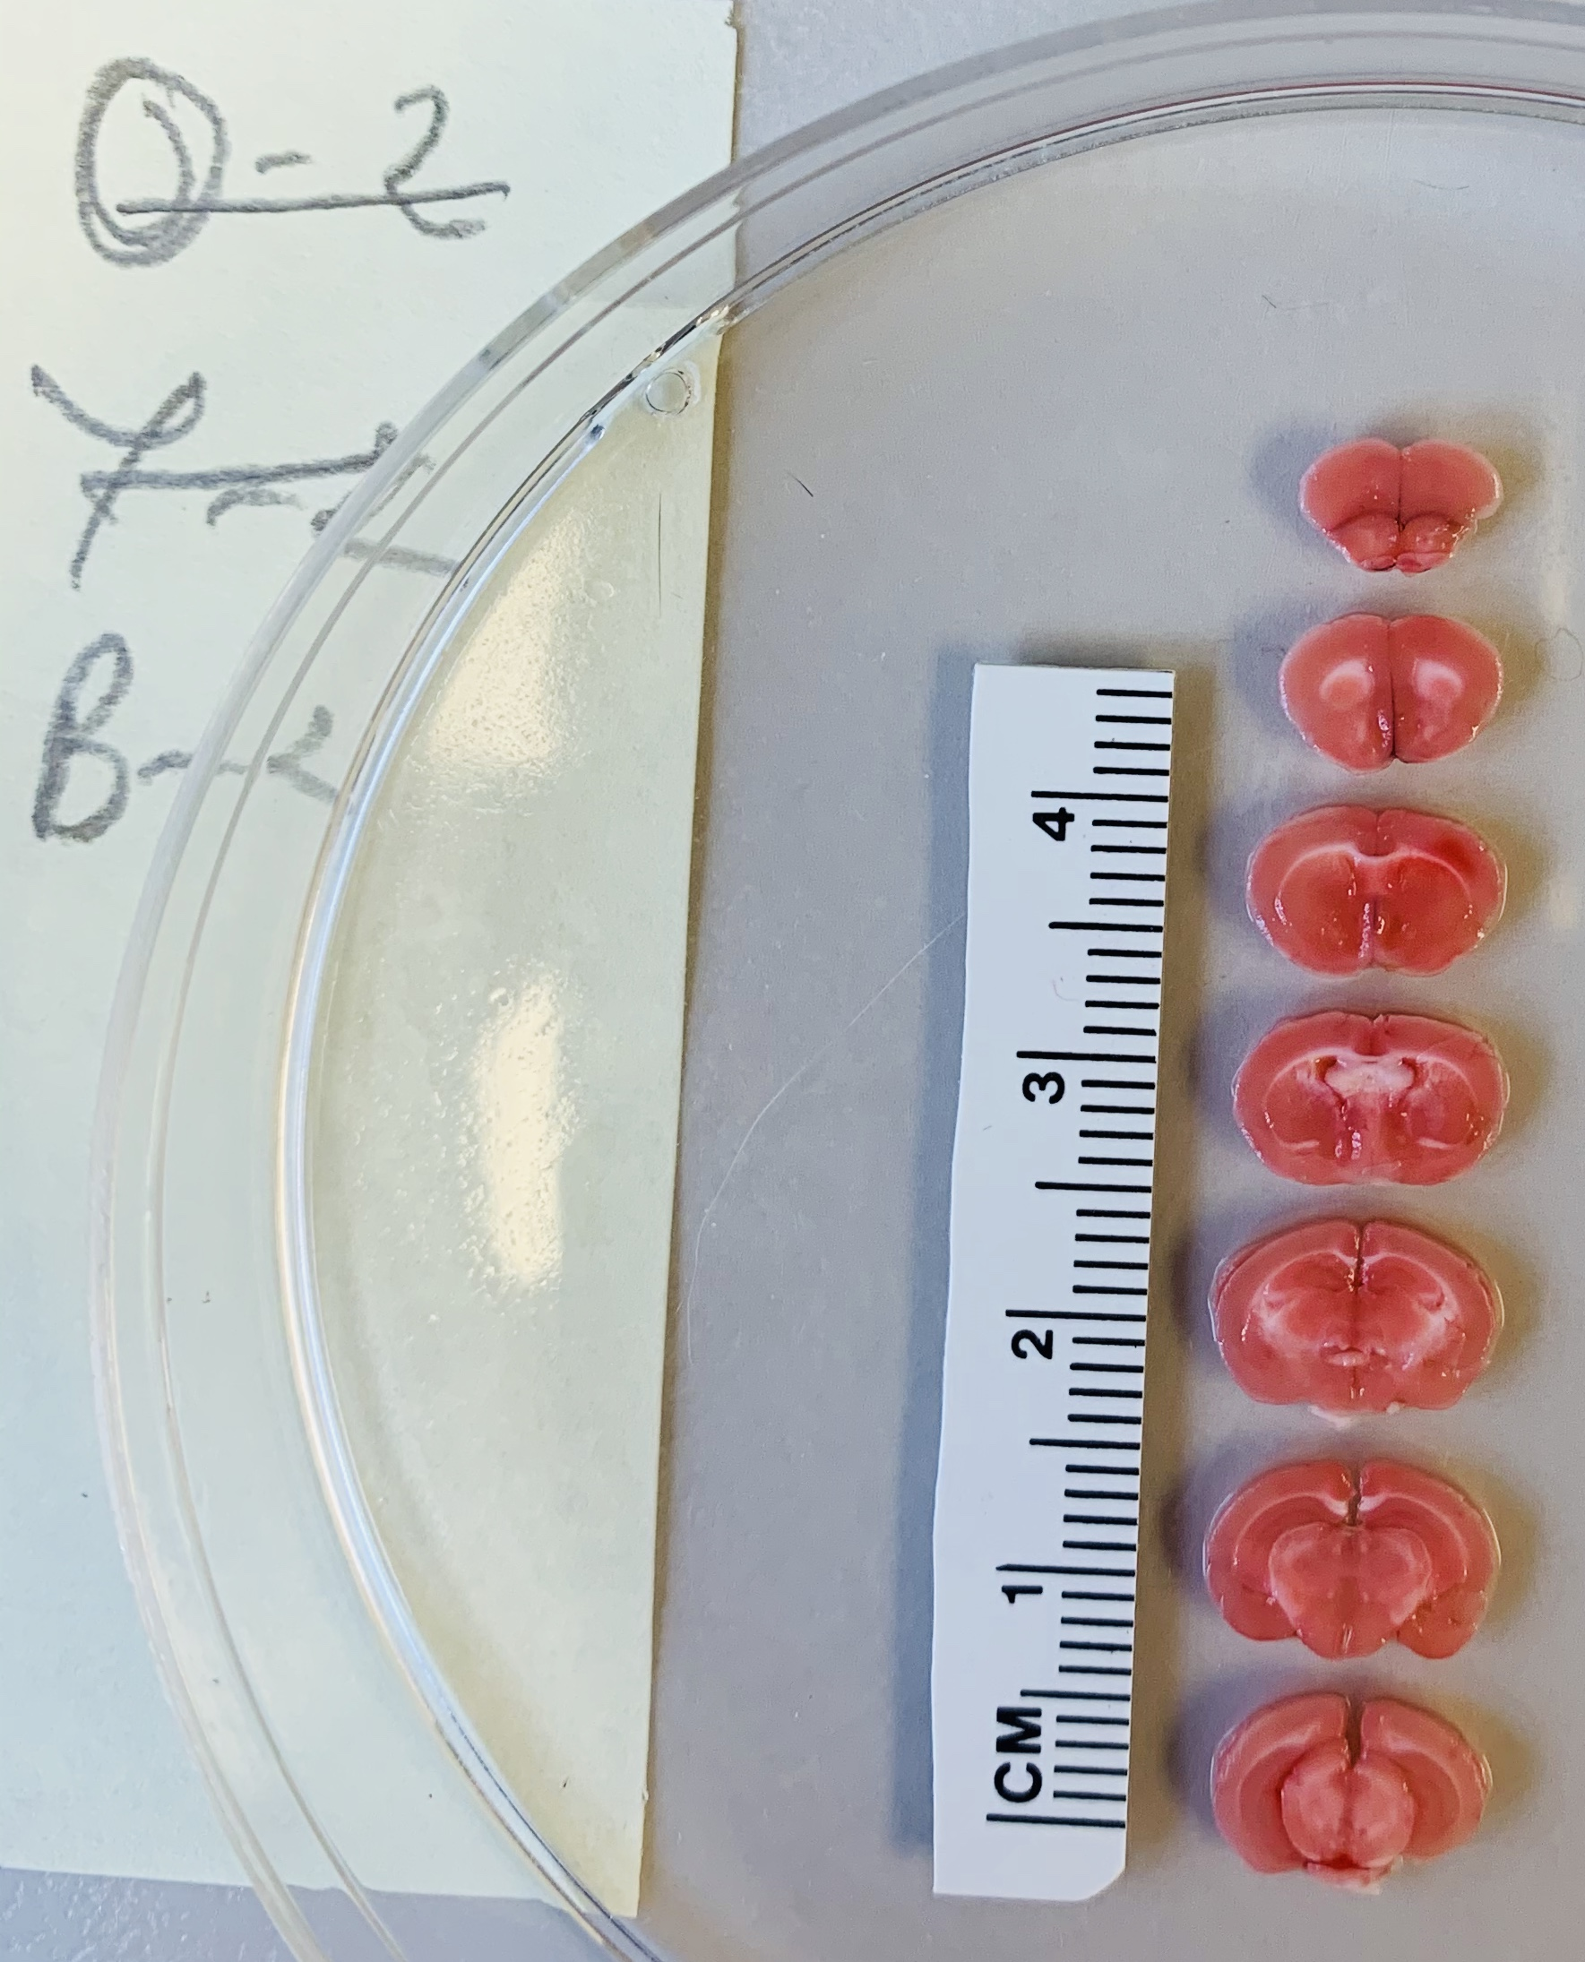
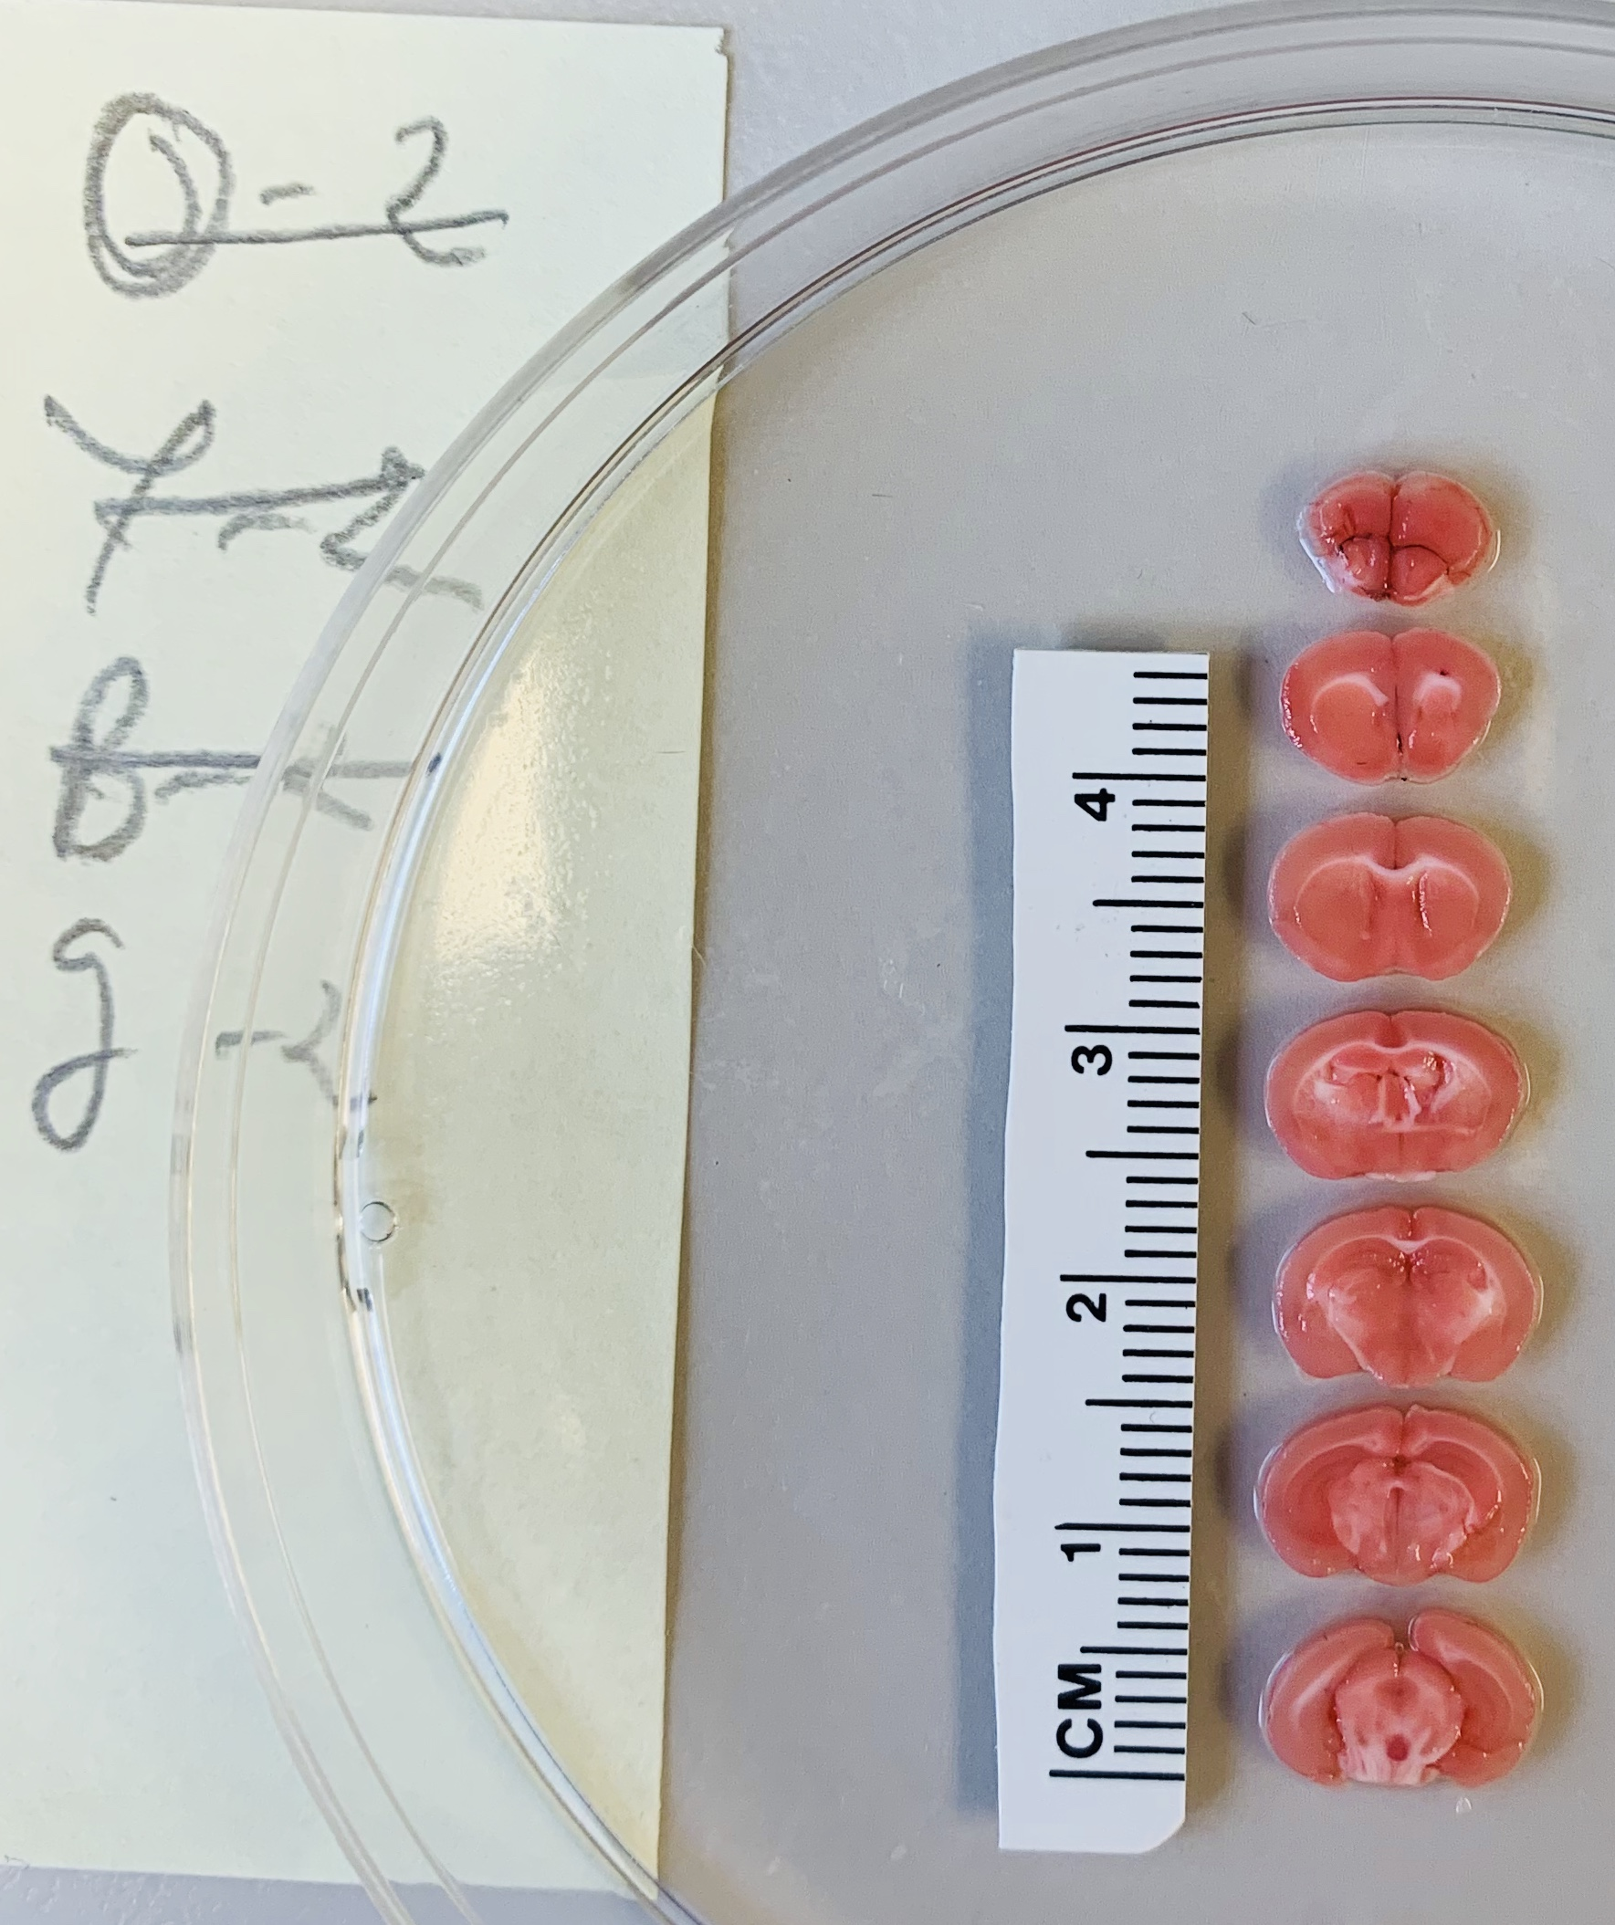
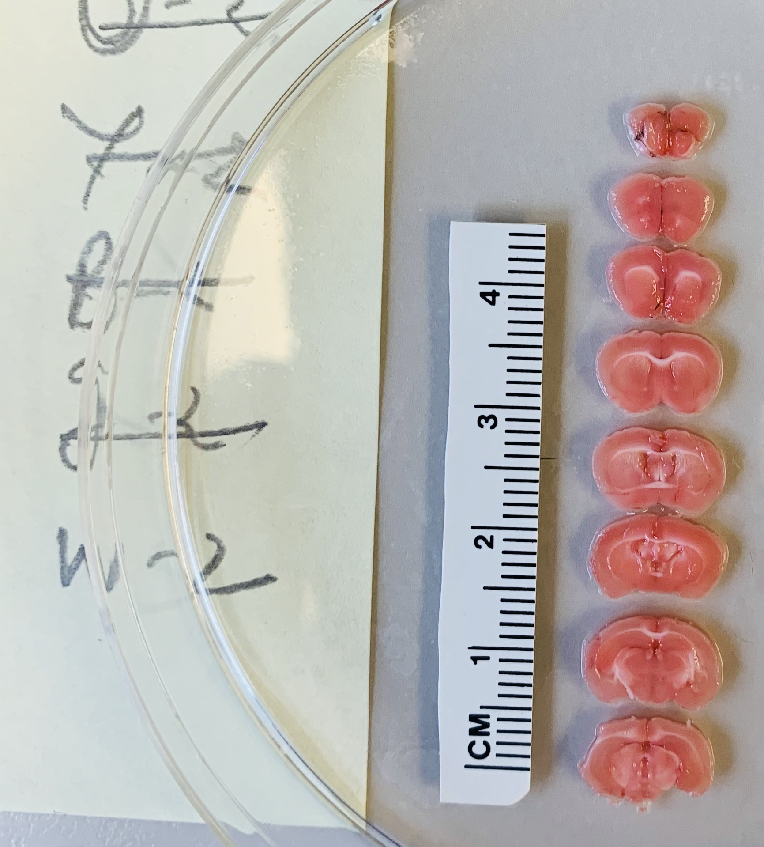
KX0560
AM5398
QC3810
VH1900
FR4960

Slide 3
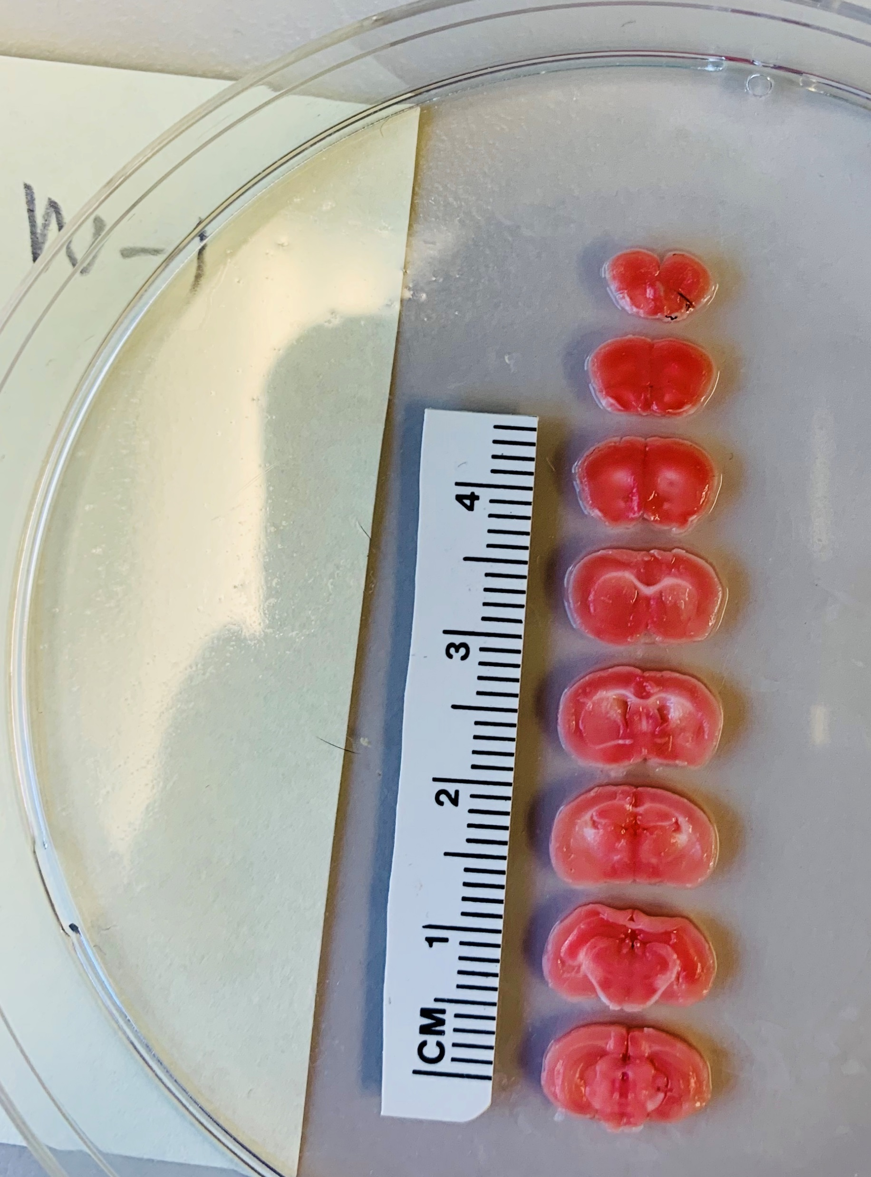
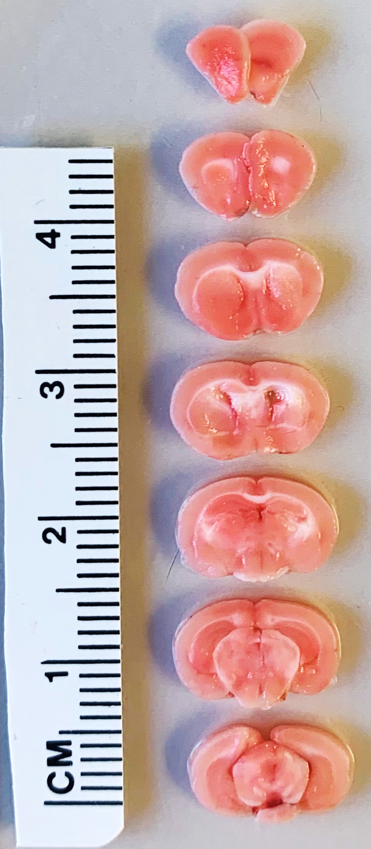
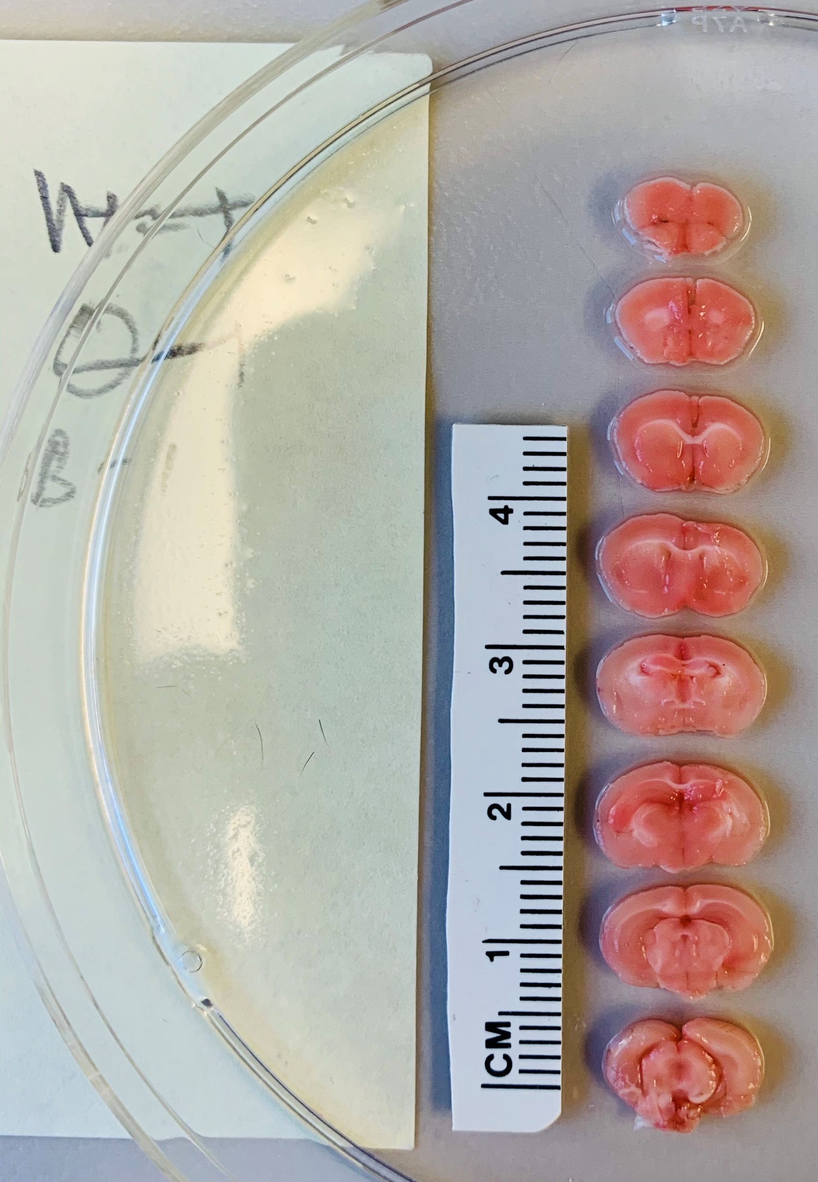
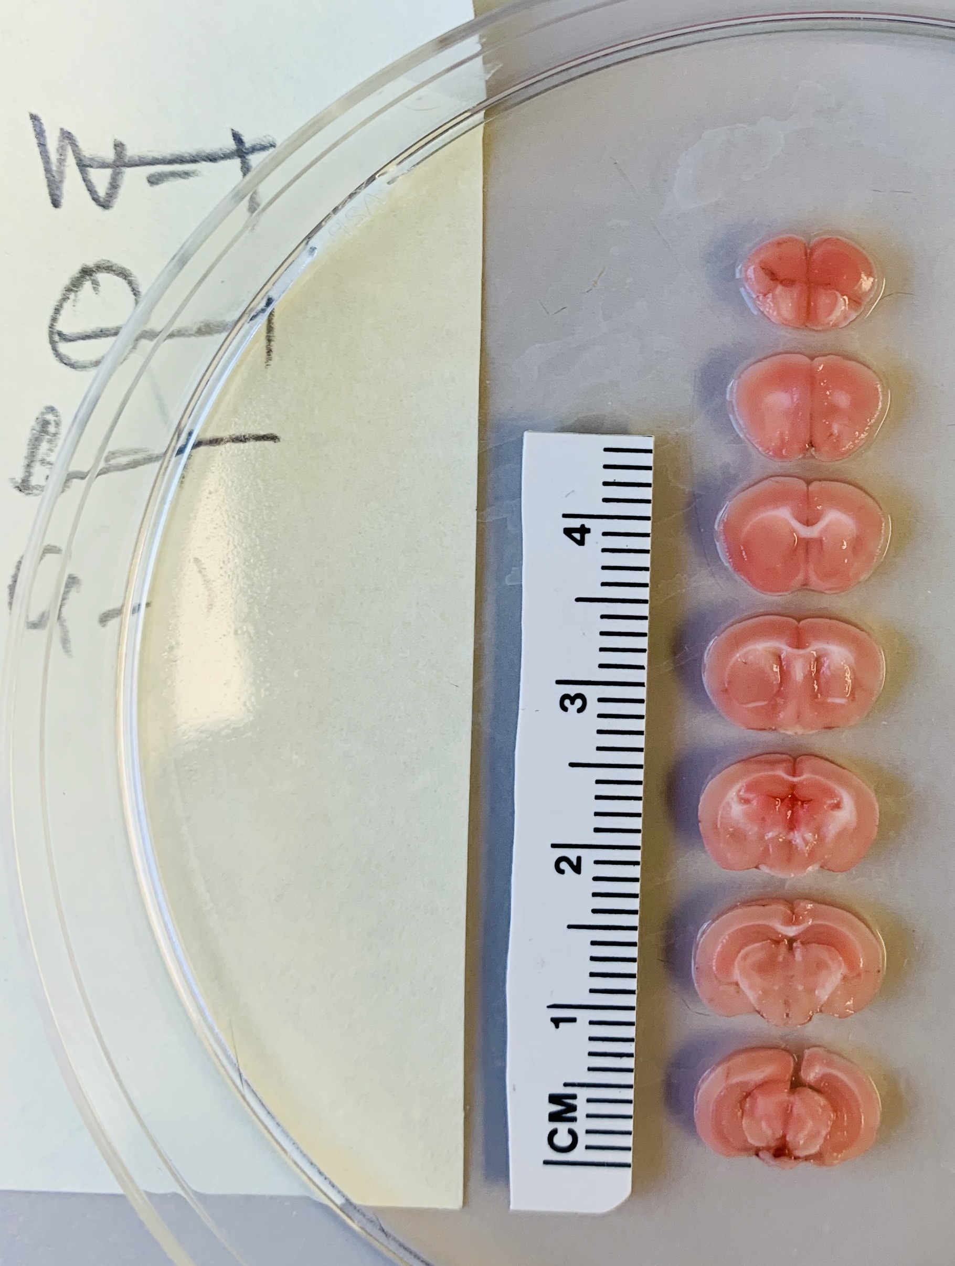
FR4979
KX0579
QC3809
VH1919

